Slide 1
Baseline Code
V0 and V1 Submission

Slide 2
Phase I Modeling & Simulation
The modeling cycle we attempted
Scaling analysis
The modeling cycle we implemented
Mirror Results

Slide 3
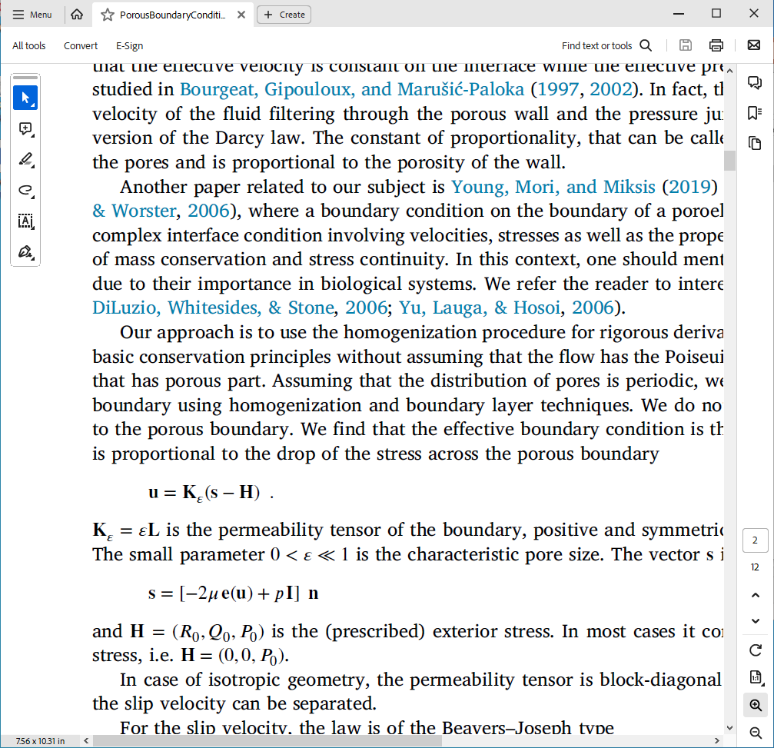
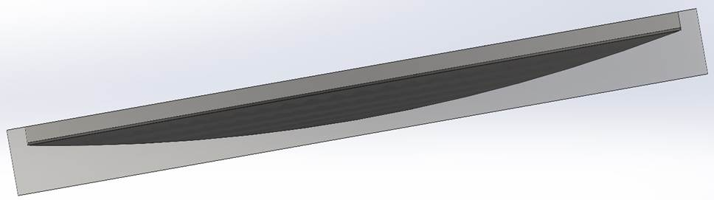
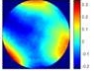
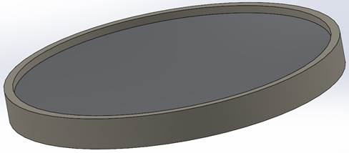
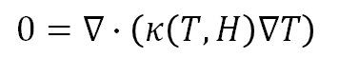
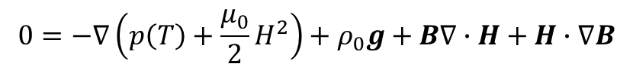
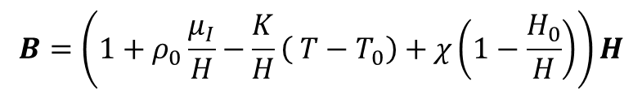
Modeling Flow
Compute B Field Given:
Structural Geometry, Fluid Properties & Coils Layout
Lower Boundary Condition
Initial Optical Surface Shape
And Loading
$$0=−∇\left(p\left(T\right)+\frac{μ_{0}}{2}H^{2}\right)+ρ_{0}g+B∇∙H+H∙∇B$$
g
$$B=\left(1+ρ_{0}\frac{μ_{I}}{H}−\frac{K}{H}\left( T−T_{0}\right)+χ\left(1−\frac{H_{0}}{H}\right)\right)H$$
$$0=∇∙\left(κ\left(T,H\right)∇T\right)$$
Initial Tools:
ANSYS Maxwell for B-Field Optimization
ANSYS Fluent for fluid dynamics
+
Update Surface Shape,
Coil Positions, and Ferrofluid Properties and Restart Modeling Loop
Compute Optical Surface
Given Real Currents
Initial Tools:
ZEMAX for optical properties
Estimate Optical Quality And Wavefront Error

Slide 4
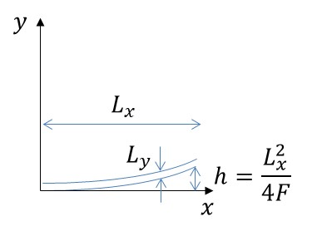
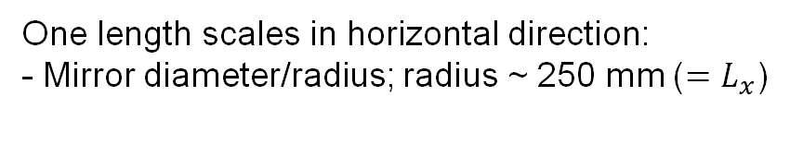
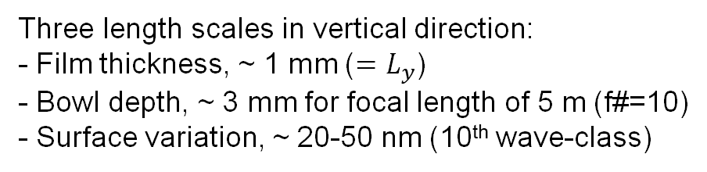
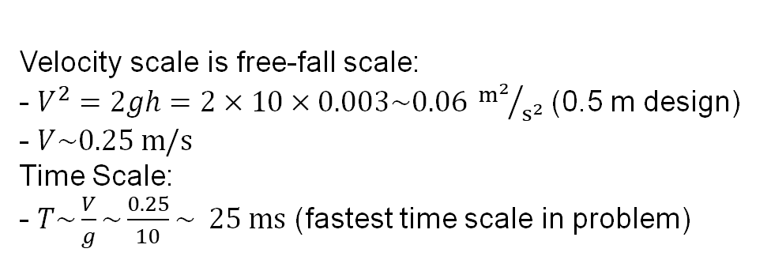
Mirror Dimensional Scales
One length scales in horizontal direction:
- Mirror diameter/radius; radius ~ 250 mm ($=L_{x}$)
Three length scales in vertical direction:
- Film thickness, ~ 1 mm ($=L_{y}$)
- Bowl depth, ~ 3 mm for focal length of 5 m (f#=10)
- Surface variation, ~ 20-50 nm (10th wave-class)
Velocity scale is free-fall scale:
- $V^{2}=2gh=2×10×0.003\sim 0.06 {m^{2}}/{s^{2}}$ (0.5 m design)
- $V\sim 0.25 m/s$
Time Scale:
- $T\sim \frac{V}{g}\sim \frac{0.25}{10}\sim 25 ms$ (fastest time scale in problem)
Reflective
Surface
Ferrofluid
Mechanical
Substrate
This is why Fluent is having issues

Slide 5
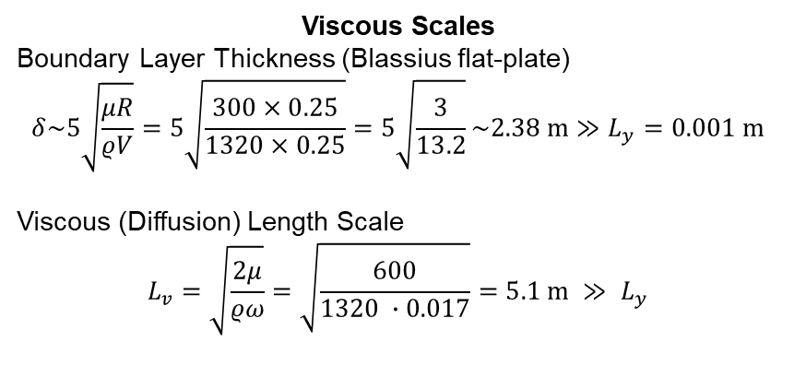
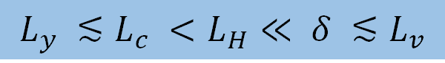
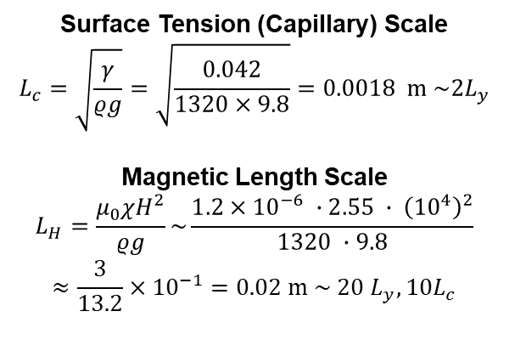
Ferrofluid Properties and Scales
Surface Tension (Capillary) Scale
$$L_{c}=\sqrt{\frac{γ}{ρg}}=\sqrt{\frac{0.042}{1320×9.8}}=0.0018 m \sim 2L_{y}$$
Magnetic Length Scale
$$L_{H}=\frac{μ_{0}χH^{2}}{ρg}\sim \frac{1.2×{10}^{−6} ∙2.55 ∙ {\left({10}^{4}\right)}^{2}}{1320 ∙9.8}$$
$$≈\frac{3}{13.2}×{10}^{−1}=0.02 m \sim 20 L_{y}, 10L_{c}$$
Viscous Scales
Boundary Layer Thickness (Blassius flat-plate)
$$δ\sim 5\sqrt{\frac{μR}{ρV}}=5\sqrt{\frac{300×0.25}{1320×0.25}}=5\sqrt{\frac{3}{13.2}}\sim 2.38 m≫L_{y}=0.001 m$$
Viscous (Diffusion) Length Scale
$$L_{v}=\sqrt{\frac{2μ}{ρω}}=\sqrt{\frac{600}{1320 ∙0.017}}=5.1 m ≫ L_{y}$$
$$L_{y} ≲L_{c} <L_{H}≪ δ ≲L_{v}$$

Slide 6
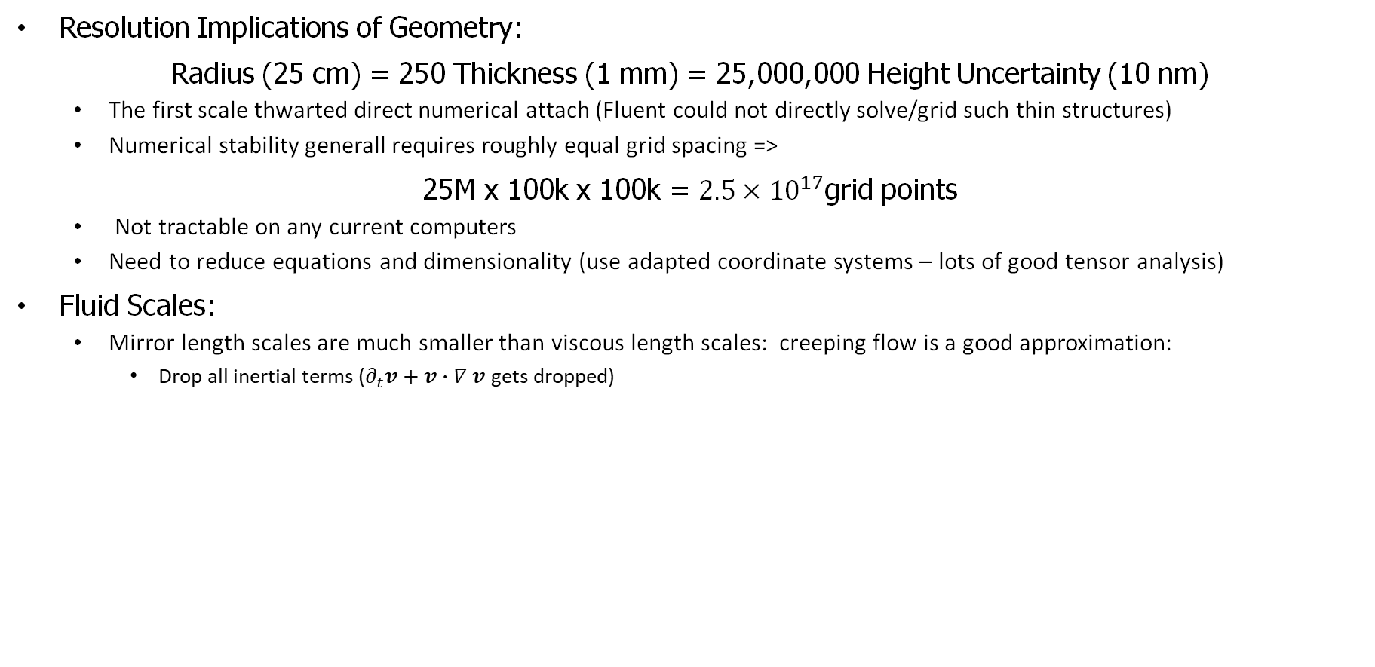
Scale Implications
Resolution Implications of Geometry:
Radius (25 cm) = 250 Thickness (1 mm) = 25,000,000 Height Uncertainty (10 nm)
The first scale thwarted direct numerical attach (Fluent could not directly solve/grid such thin structures)
Numerical stability generall requires roughly equal grid spacing =>
25M x 100k x 100k = $2.5×{10}^{17}$grid points
Not tractable on any current computers
Need to reduce equations and dimensionality (use adapted coordinate systems – lots of good tensor analysis)
Fluid Scales:
Mirror length scales are much smaller than viscous length scales: creeping flow is a good approximation:
Drop all inertial terms ($∂_{t}v+v∙∇ v$gets dropped)

Slide 7
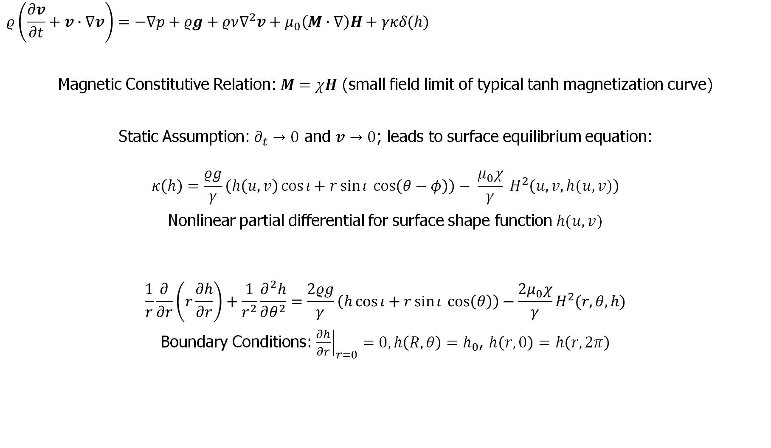
Fluid Modeling Governing Physics
Lower Boundary Condition
$$ρ\left(\frac{∂v}{∂t}+v∙∇v\right)=−∇p+ρg+ρν∇^{2}v+μ_{0}\left(M∙∇\right)H+γκδ(h)$$
Magnetic Constitutive Relation: $M=χH$ (small field limit of typical tanh magnetization curve)
Static Assumption: $∂_{t}→0$ and $v→0$; leads to surface equilibrium equation:
$$κ\left(h\right)=\frac{ρg}{γ}\left(h\left(u,v\right)\cos{ι}+r\sin{ι} \cos\left(θ−φ\right)\right)− \frac{μ_{0}χ}{γ} H^{2}\left(u,v,h(u,v)\right)$$
Nonlinear partial differential for surface shape function $h(u,v)$
$$\frac{1}{r}\frac{∂}{∂r}\left(r\frac{∂h}{∂r}\right)+\frac{1}{r^{2}}\frac{∂^{2}h}{∂θ^{2}}=\frac{2ρg}{γ}\left(h\cos{ι}+r\sin{ι} \cos\left(θ\right)\right)−\frac{2μ_{0}χ}{γ}H^{2}(r,θ,h)$$
Boundary Conditions: ${\left.\frac{∂h}{∂r}\right|}_{r=0}=0, h\left(R,θ\right)=h_{0}$, $h\left(r,0\right)=$ $h\left(r,2π\right)$

Slide 8
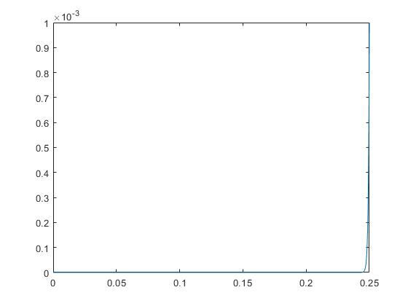
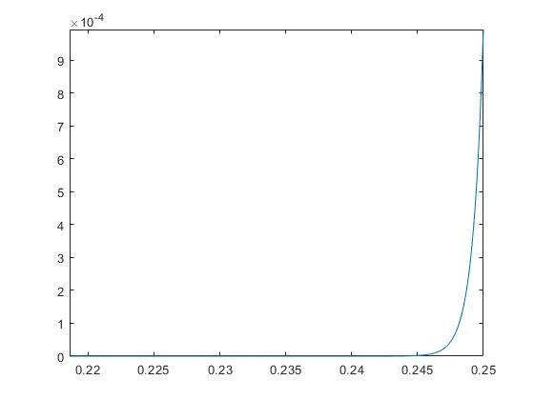
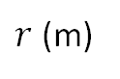
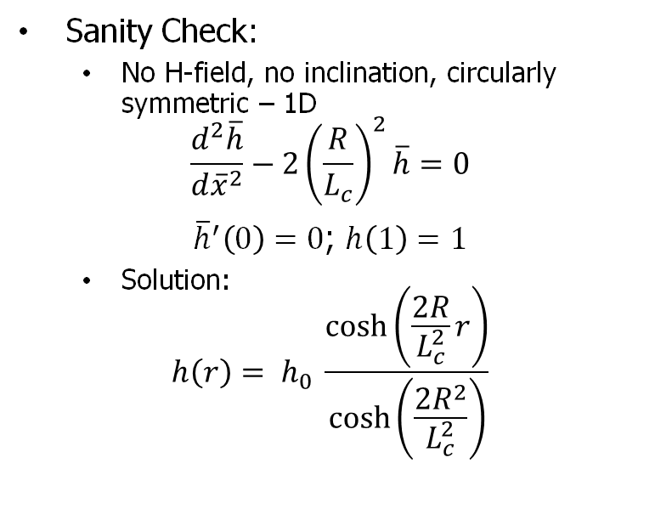
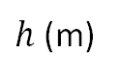
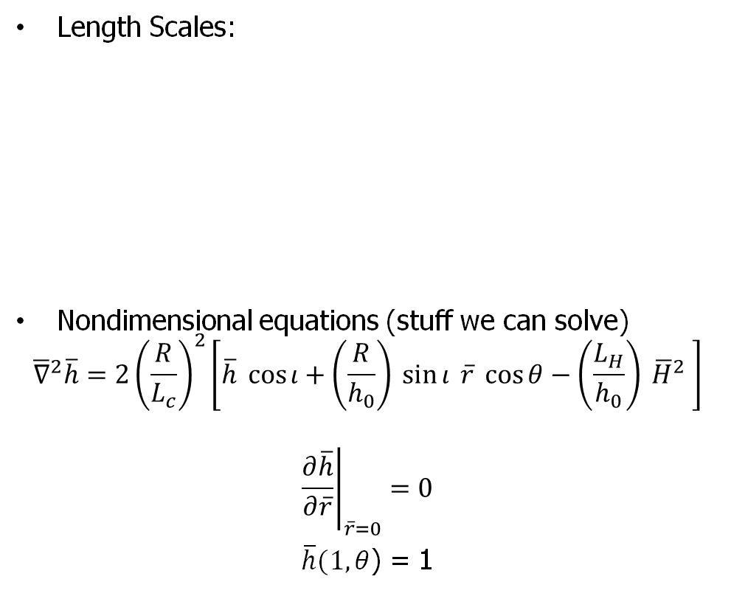
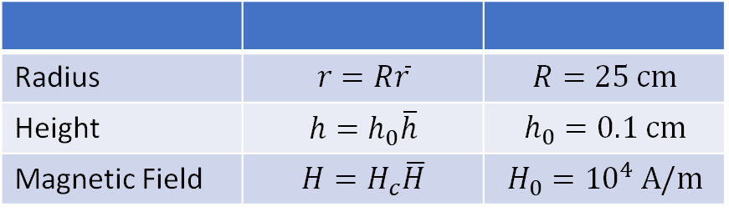
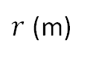
Numerical Analysis 1
Length Scales:
Nondimensional equations (stuff we can solve)
$${\overline{∇}}^{2}\overline{h}=2{\left(\frac{R}{L_{c}}\right)}^{2}\left[\overline{h} \cos{ι}+\left(\frac{R}{h_{0}}\right) \sin{ι} \overline{r} \cos{θ}−\left(\frac{L_{H}}{h_{0}}\right) {\overline{H}}^{2} \right]$$
$${\left.\frac{∂\overline{h}}{∂\overline{r}}\right|}_{\overline{r}=0}=0$$
$\overline{h}(1,θ$) = 1
Sanity Check:
No H-field, no inclination, circularly symmetric – 1D
$$\frac{d^{2}\overline{h}}{d{\overline{x}}^{2}}−2{\left(\frac{R}{L_{c}}\right)}^{2}\overline{h}=0$$
${\overline{h}}^{′}\left(0\right)=0$; $h\left(1\right)=1$
Solution:
$$h\left(r\right)= h_{0} \frac{\cosh\left(\frac{2R}{L_{c}^{2}}r\right)}{\cosh\left(\frac{2R^{2}}{L_{c}^{2}}\right)}$$
Radius | $$r=R\overline{r}$$ | $$R=25 cm$$
Height | $$h=h_{0}\overline{h}$$ | $$h_{0}=0.1 cm$$
Magnetic Field | $$H=H_{c}\overline{H}$$ | $$H_{0}={10}^{4} A/m$$
$h$ (m)
$h$ (m)
Thin Layers Emerge… Numerically hard!!
$r$ (m)
$r$ (m)

Slide 9
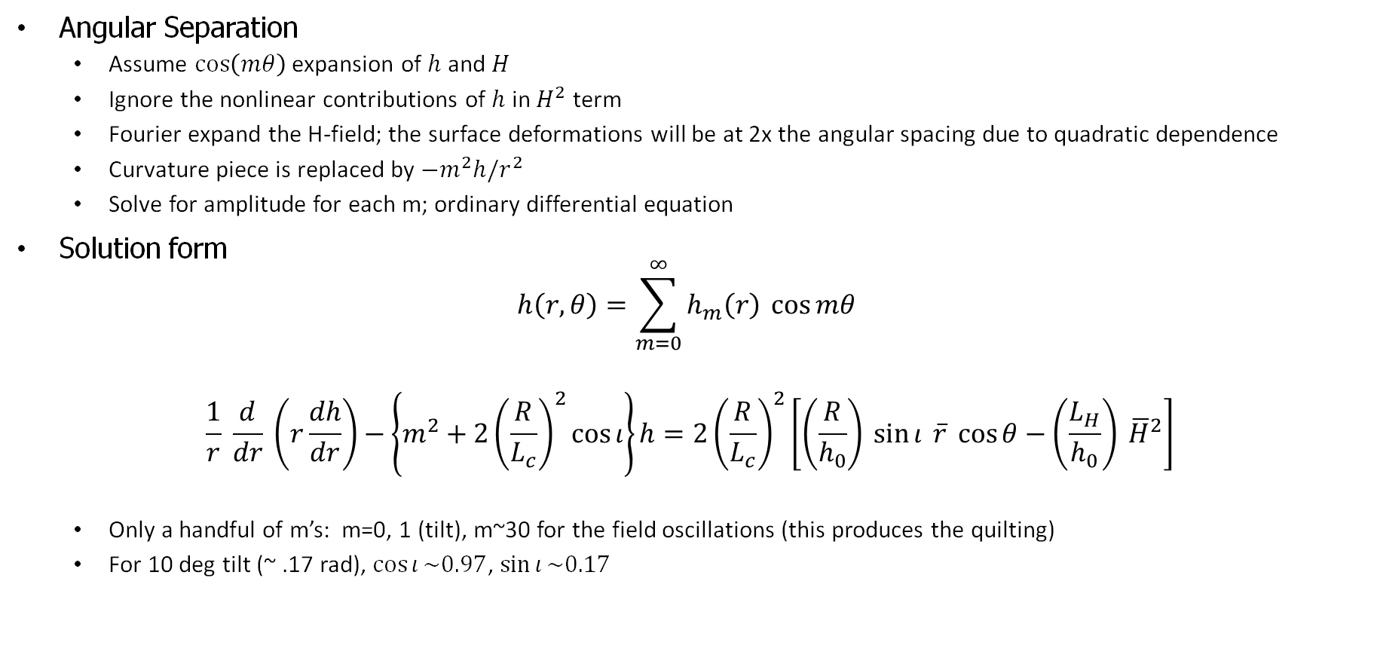
Numerical Approach
Angular Separation
Assume $\cos\left(mθ\right)$ expansion of $h$ and $H$
Ignore the nonlinear contributions of $h$ in $H^{2}$ term
Fourier expand the H-field; the surface deformations will be at 2x the angular spacing due to quadratic dependence
Curvature piece is replaced by $−m^{2}h/r^{2}$
Solve for amplitude for each m; ordinary differential equation
Solution form
$$h\left(r,θ\right)=\sum_{m=0}^{∞}{h_{m}\left(r\right) \cos{mθ}}$$
$$\frac{1}{r} \frac{d}{dr} \left(r\frac{dh}{dr}\right)−\left\{m^{2}+2{\left(\frac{R}{L_{c}}\right)}^{2}\cos{ι}\right\}h=2{\left(\frac{R}{L_{c}}\right)}^{2}\left[\left(\frac{R}{h_{0}}\right) \sin{ι} \overline{r} \cos{θ}−\left(\frac{L_{H}}{h_{0}}\right) {\overline{H}}^{2}\right]$$
Only a handful of m’s: m=0, 1 (tilt), m~30 for the field oscillations (this produces the quilting)
For 10 deg tilt (~ .17 rad), $\cos{ι}\sim 0.97$, $\sin{ι}\sim 0.17$

Slide 10
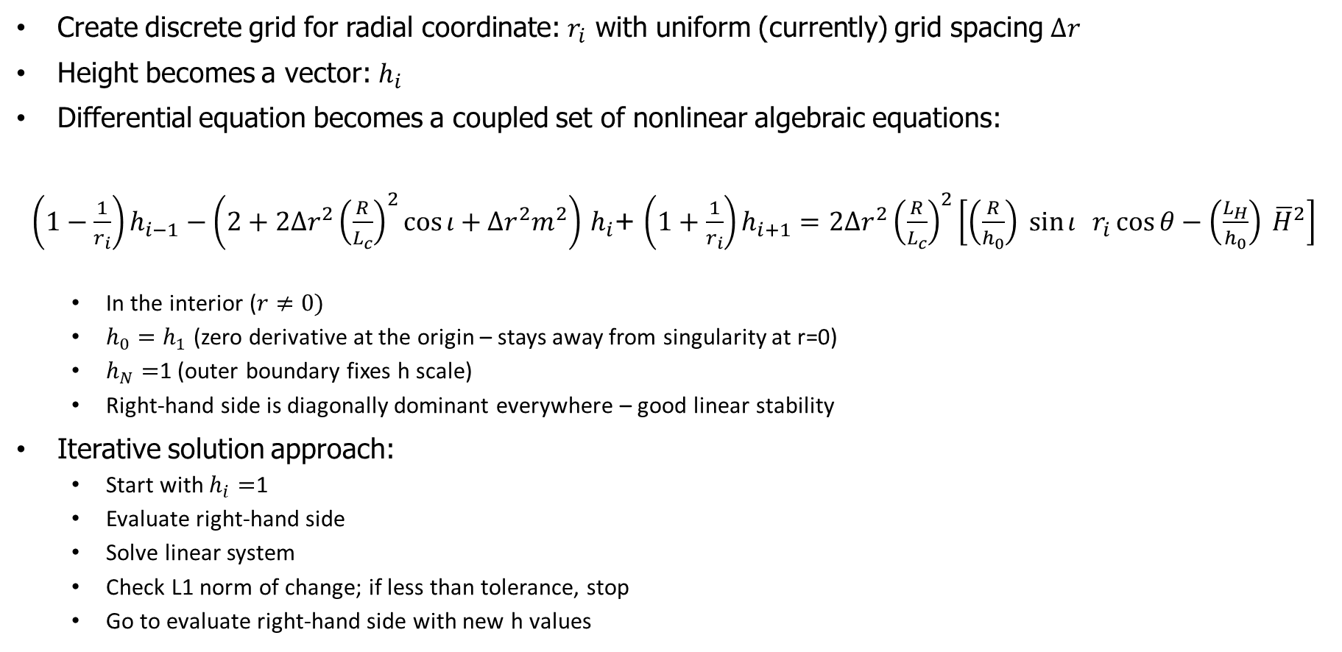
Discretization and Numerical Approach
Create discrete grid for radial coordinate: $r_{i}$ with uniform (currently) grid spacing $∆r$
Height becomes a vector: $h_{i}$
Differential equation becomes a coupled set of nonlinear algebraic equations:
$\left(1−\frac{1}{r_{i}}\right)h_{i−1}−\left(2+2{∆r}^{2}{\left(\frac{R}{L_{c}}\right)}^{2}\cos{ι}+{∆r}^{2}m^{2}\right)$ $h_{i}$+ $\left(1+\frac{1}{r_{i}}\right)h_{i+1}=$ $2{∆r}^{2}{\left(\frac{R}{L_{c}}\right)}^{2}\left[\left(\frac{R}{h_{0}}\right) \sin{ι} r_{i}\cos{θ}−\left(\frac{L_{H}}{h_{0}}\right) {\overline{H}}^{2}\right]$
In the interior ($r≠0)$
$h_{0}=h_{1}$ (zero derivative at the origin – stays away from singularity at r=0)
$h_{N}=$1 (outer boundary fixes h scale)
Right-hand side is diagonally dominant everywhere – good linear stability
Iterative solution approach:
Start with $h_{i}=$1
Evaluate right-hand side
Solve linear system
Check L1 norm of change; if less than tolerance, stop
Go to evaluate right-hand side with new h values

Slide 11
Exploring Staggered Coil Distribution – 3/18/2024
The Staggered coil distribution was explored over the full circular basis area with different values of slope in the z-coordinates of the coil centers from edge toward the mirror center.
A slope factor of 1.0 corresponds to a change in z-coordinates of 1 coil radius (0.012m) from center towards the mirror edge.
Following charts show:
Radial distribution of H_mag
Contour surfaces for magnetic field energy
Relative values 0.8, 0.5, 0.3, 0.1, 0.05

Slide 12
z-slope 1.0

Slide 13
z-slope 0.5

Slide 14
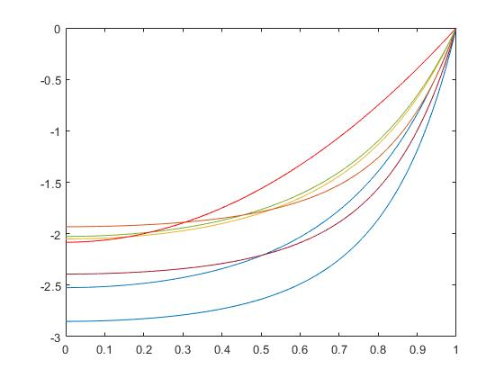
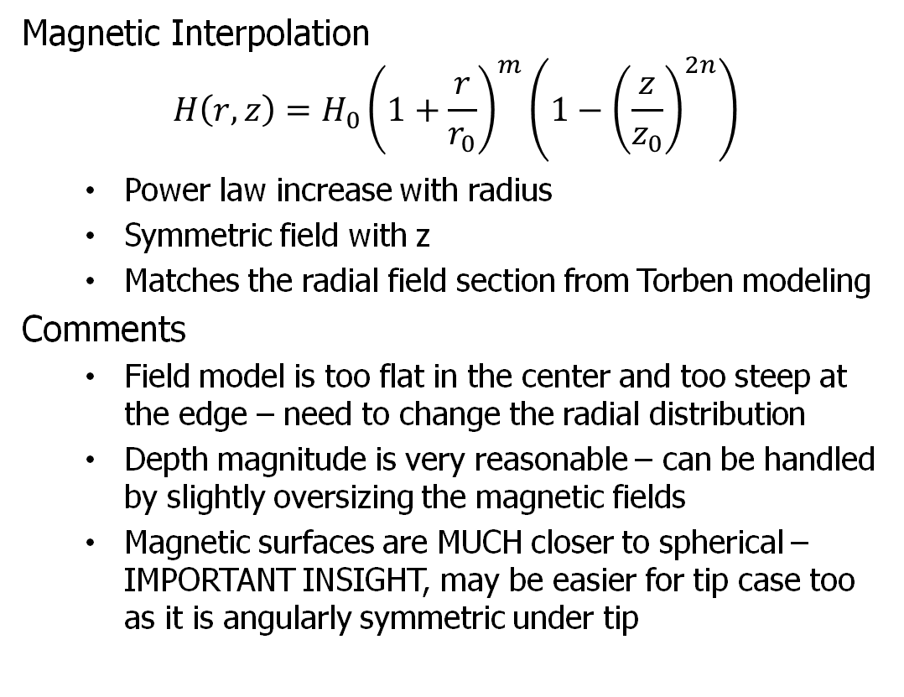
Some Static Surface Modeling Results
Magnetic Interpolation
$$H\left(r,z\right)=H_{0}{\left(1+\frac{r}{r_{0}}\right)}^{m}\left(1−{\left(\frac{z}{z_{0}}\right)}^{2n}\right)$$
Power law increase with radius
Symmetric field with z
Matches the radial field section from Torben modeling
Comments
Field model is too flat in the center and too steep at the edge – need to change the radial distribution
Depth magnitude is very reasonable – can be handled by slightly oversizing the magnetic fields
Magnetic surfaces are MUCH closer to spherical – IMPORTANT INSIGHT, may be easier for tip case too as it is angularly symmetric under tip
h (mm)
Ideal Paraboloid
Surface Shapes for Different Field Configurations
r/R
Numerical Approach is Generating Reasonable Surfaces

Slide 15
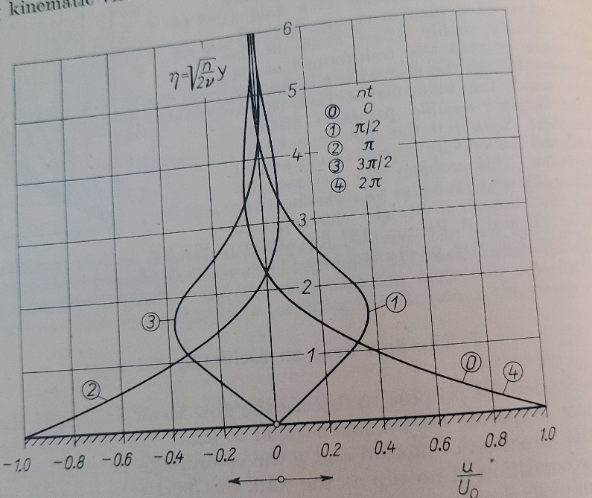
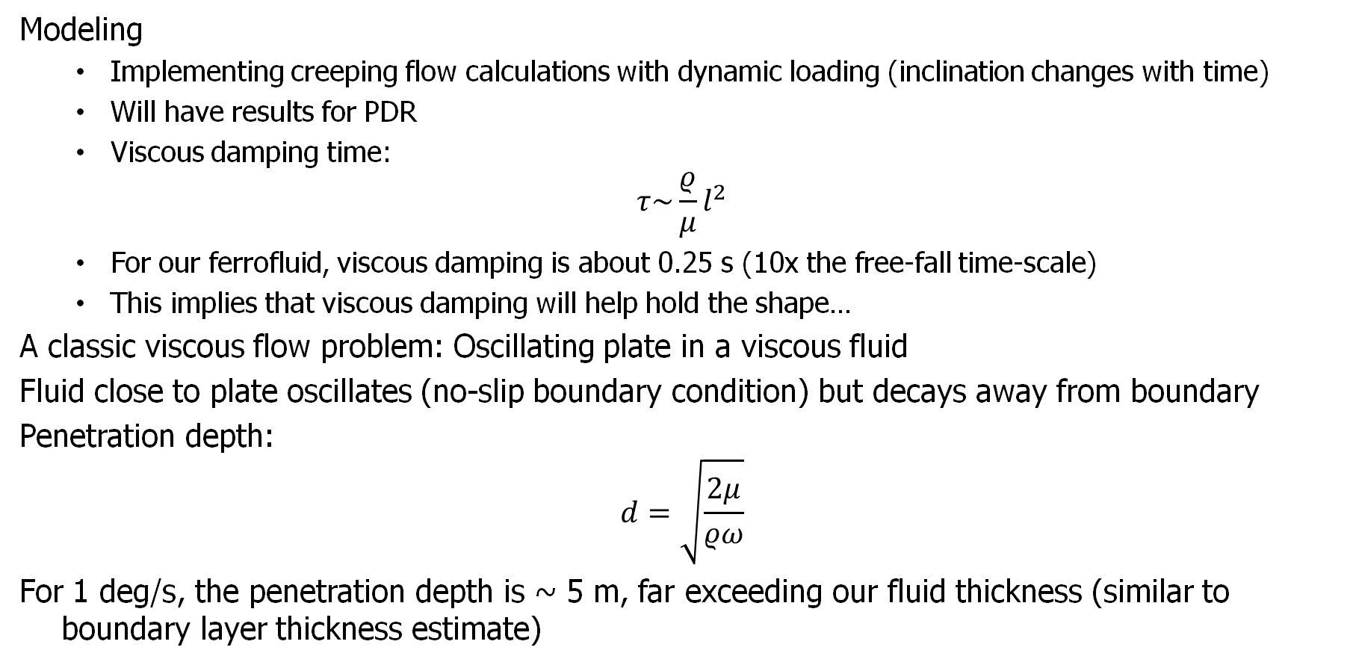
Slew Dynamic Analysis
Modeling
Implementing creeping flow calculations with dynamic loading (inclination changes with time)
Will have results for PDR
Viscous damping time:
$$τ\sim \frac{ρ}{μ}l^{2}$$
For our ferrofluid, viscous damping is about 0.25 s (10x the free-fall time-scale)
This implies that viscous damping will help hold the shape…
A classic viscous flow problem: Oscillating plate in a viscous fluid
Fluid close to plate oscillates (no-slip boundary condition) but decays away from boundary
Penetration depth:
$$d=\sqrt{\frac{2μ}{ρω}}$$
For 1 deg/s, the penetration depth is ~ 5 m, far exceeding our fluid thickness (similar to boundary layer thickness estimate)
Viscosity Helps Hold Shape

Slide 16
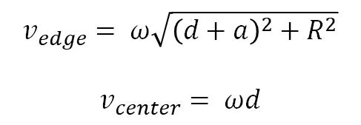
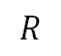
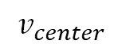
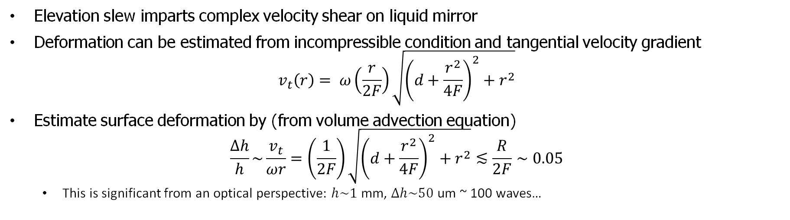
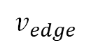
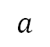
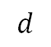
Deformation Magnitudes Under Elevation Slewing Conditions
Velocities Under Elevation Slew
$$v_{edge}$$
$$v_{edge}= ω\sqrt{{\left(d+a\right)}^{2}+R^{2}}$$
$$v_{center}= ωd$$
$$v_{center}$$
$$a$$
$$d$$
Rotation
Axis
$$R$$
Elevation slew imparts complex velocity shear on liquid mirror
Deformation can be estimated from incompressible condition and tangential velocity gradient
$$v_{t}\left(r\right)= ω\left(\frac{r}{2F}\right)\sqrt{{\left(d+\frac{r^{2}}{4F}\right)}^{2}+r^{2}}$$
Estimate surface deformation by (from volume advection equation)
$$\frac{∆h}{h}\sim \frac{v_{t}}{ωr}=\left(\frac{1}{2F}\right)\sqrt{{\left(d+\frac{r^{2}}{4F}\right)}^{2}+r^{2}}≲\frac{R}{2F}∼0.05$$
This is significant from an optical perspective: $h\sim 1$mm, $∆h\sim 50$ um ~ 100 waves…
Slewing needs some more careful consideration.

Slide 17
Modeling Items Included in V1
Porous lower boundary and wicking structures
Need to estimate wicking forces as function of porosity
Done through porous boundary condition and surface tension
Magnetic field interpolation improvements
Improve field resolution
Estimate gradient forces
Re-examine the angular decomposition approximation
More detailed static modeling
2D computations
Magnetic field optimizations
More careful dynamic modeling
Not successfully implemented in code

Slide 18
V1 Update Code

Slide 19
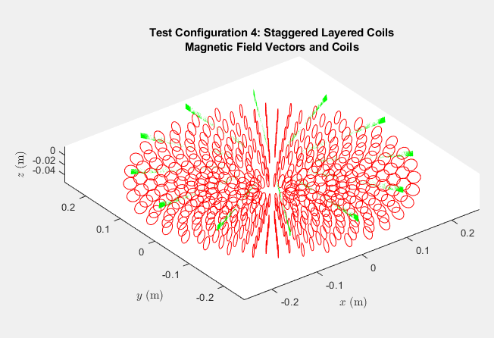
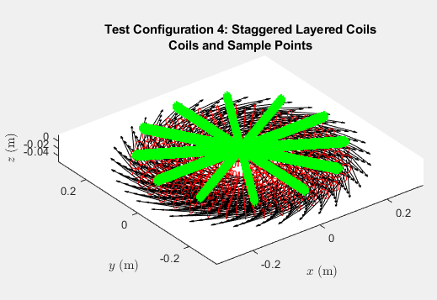
Initial magnetic field values are computed on a grid of 251 radial values, 12 angular values and 21 heights. The initial calculation on these grid points is time consuming and will need to be performed at least every time current to coils is modified.
We will likely have different grids for magnetic field and fluid flow models. We will need to be able interpolate the results of the magnetic field calculations to the fluid flow grid.

Slide 20
r
The plots below are 3D interpolations displayed in 2D
θ
z
Interpolate first in radial and angular dimensions
Then in z dimension

Slide 21
Near center
The plots on the left are zoomed in from 251 radial positions, 13 angles and 21 z positions. It takes about 53 seconds to generate the field magnitude on that grid. Finer grids are more expensive.
Near edge

